Slide 1
DNA viruses
Dr. R. Bindhusaran, Associate professor
DEPT OF PATHOLOGY, SKHMC, Kulasekharam

Slide 2
LABORATORY DIAGNOSIS
Direct Demonstration of Virus
• Electron microscopy
• lmmunoelectron microscopy
D Fluorescent microscopy
• Light microscopy:
• Histopathological staining: To demonstrate inclusion bodies
• lmmunoperoxidase staining

Slide 3
LABORATORY DIAGNOSIS
Detection of Viral Antigens
By various formats such as ELISA, direct IF, ICT, flow throughassays.
Detection of the Specific Antibodies
• Conventional techniques such as HAI, neutralization test and CFT
• Newer diagnostic formats such as ELISA, ICT, flow through assays.)

Slide 4
LABORATORY DIAGNOSIS
Molecular Methods to Detect Viral Genes
• Nucleic acid probe-for detection of DNA or RNA by hybridization
• PCR- for DNA detection by amplification, RT-PCR- for RNA detection
• Real time PCR- for DNA quantification
• Real time RT-PCR- for RNA quantification.
Isolation of Virus by
• Animal inoculation
D Embryonated egg inoculation
D Tissue cultures:Organ culture, explant culture, cell line culture (primary, secondary and continuous cell lines

Slide 5
LABORATORY DIAGNOSIS
Polymerase Chain Reaction
PCR has revolutionized the diagnostic virology. It involves three basic steps-(1) viral DNA extraction from the specimen, (2) amplification of specific region of viral DNA
to 107 folds, (3) detection of amplified products by gel electrophoresis.
Reverse Transcriptase PCR (RT-PCR)
RT-PCR is used for the detection of RNA viruses. After RNA extraction, the viral RNA is reverse transcribed to DNA, which is then subjected to amplification similar to that followed in PCR.
Both PCR and RT-PCR cannot quantify the viral nucleic acid load in the specimen.

Slide 6
Real Time PCR
It has the advantage of quantifying viral nucleic acid in the samples, hence used to monitor the treatment response, e.g., monitoring the response to antiretroviral therapy.
More so, it takes much less time than PCR as the amplification is visualized on real time basis.

Slide 7
The herpesvirus family contains over a hundred species of enveloped DNA viruses that affect humans and animals.
They are characterised by their ability to establish latent infections, enabling the virus to persist indefinitely within infected hosts and to undergo periodic reactivation.

Slide 8
Morphology
The herpesvirus capsid is icosahedral (In geometry, an icosahedron is a polyhedron with 20 faces) , composed of 162 capsomers (The capsomere is a subunit of the capsid, an outer covering of protein that protects the genetic material of a virus.
Capsomeres self-assemble to form the capsid), and enclosing the core containing the linear double-stranded DNA genome.
The nucleocapsid is surrounded by the lipid envelope derived from the modified host cell nuclear membrane through which the naked virions bud during replication.

Slide 9
Herpesviruses replicate in the host cell nucleus. They form intranuclear (Lipschutz) inclusion bodies.
Like other enveloped viruses, herpesviruses are susceptible to fat solvents like alcohol, ether, chloroform and bile salts.

Slide 10
Herpesviridae is divided into three subfamilies
Alpha herpesviruses: with a relatively short replicative cycle (12-1 8 hours), variable host range and a tendency to cause latent infection (Virus latency (or viral latency) is the ability of a pathogenic virus to lie dormant (latent) within a cell) in sensory ganglia.Eg. herpes simplex virus, varicella zoster virus.

Slide 11
Beta herpesviruses: which replicate slowly (more than 24 hours), with a tendency to produce enlargement of infected cells (cytomegaly) and cause latent infection of salivary glands and other organs. Example-cytomegalovirus.
Gamma herpesviruses -are specific for either B or T lymphocytes and frequently cause latent infection in lymphoid tissue, for example, Epstein-Barr virus.

Slide 12
Classification
Eight different types of herpesviruses are known whose primary hosts are humans.
They have been officially designated ‘human herpesvirus types 1—8(HHV)

Slide 13
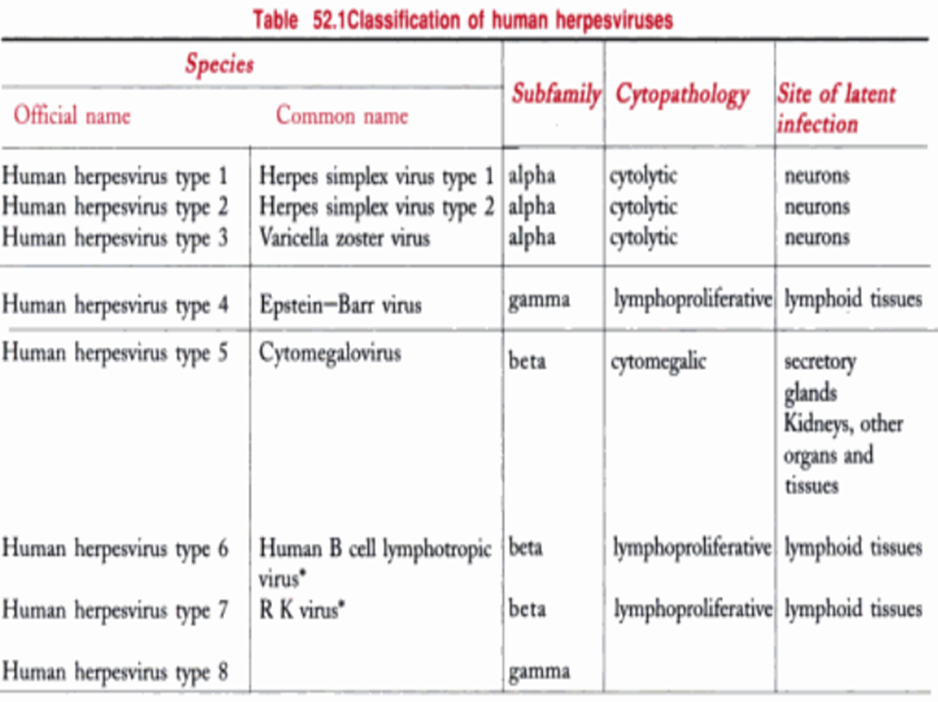

Slide 14
HERPES SIMPLEX
The herpes simplex virus (HSV) occurs naturally only in humans.
The virus is of two types.
HSV type 1 (human herpes virus type 1 or HHV type 1) is transmitted by direct contact or droplet spread from cases or carriers.
HSV type 2 (HHV type 2) is responsible for the majority of genital herpes infections and is commonly transmitted venereally.

Slide 15
Pathogenesis:
Herpes simplex is one of the most common viral infections in humans,
Primary infection is usually acquired in early childhood, between two and five years of age
Humans are the only natural hosts and the sources of infection are saliva, skin lesions or respiratory secretions.

Slide 16
Pathogenesis:
Transmission occurs by close contact and may be venereal in genital herpes.
The virus enters through defects in the skin or mucous membranes and multiplies locally, with cell-to-cell spread.
The virus enters cutaneous nerve fibres and is transported intra-axonally to the ganglia where it replicates.
Centrifugal migration of the virus can take place from the ganglia to the skin and mucosa to cause cutaneous and mucosal lesions.
The virus remains latent in the ganglia, particularly of the trigeminal (HSV type 1) and sacral (HSV type 2) nerves, to be reactivated periodically in some individuals causing recurrent oral and genital lesions.

Slide 17
Pathogenesis:
Herpes simplex is one of the most common viral infections in humans,
Primary infection is usually acquired in early childhood, between two and five years of age
Humans are the only natural hosts and the sources of infection are saliva, skin lesions or respiratory secretions.

Slide 18
Eruptions
The typical herpes lesions are thin-walled, umbilicated vesicles, the roof of which breaks down, leaving tiny superficial ulcers. They heal without scarring.
In general, primary infections, though self-limited, are more severe and widespread and associated with systemic manifestations.
Recurrent infections are more localised. As a general rule, HSV 1 produces ‘above the waist’
and HSV 2 ‘below the waist’

Slide 19
Clinical Features
Cutaneous infections:
The most common site is the face-on the cheeks, chin, around the mouth or on the forehead.
Lesions may also appear on the buttocks in infants as napkin rash.
The typical lesion is the ‘fever blister’ or herpes febrilis, caused by viral reactivation in febrile patients

Slide 20
Mucosal:
The buccal mucosa is the site most commonly affected.
Gingivostomatitis and pharyngitis are the most frequent conditions in primary infection and recurrent herpes labialis in recurrent infection.
The vesicles may ulcerate and become secondarily infected.

Slide 21
Ophthalmic:
HSV infection is the most common cause of corneal blindness in some developed countries.
Acute keratoconjunctivitis may occur by itself or by extension from facial herpes.
Follicular conjunctivitis with vesicle formation on the lids is another manifestation.

Slide 22
Nervous system:
HSV encephalitis, though rare, is the most common sporadic acute Viral encephalitis in most parts of the world.
HSV encephalitis has an acute onset, with fever and focal neurological symptoms.

Slide 23
Visceral
HSV esophagitis may cause dysphagia, substernal pain and weight loss.
It may involve the respiratory tract causing tracheobronchitis and pneumonitis

Slide 24
Genital
Lesions occur mainly on the penis, or in the urethra causing urethritis.
In women, the cervix, vagina, vulva and perineum are affected. When only the cervix is involved, the infection may be asymptomatic.
The primary infection is usually more serious, accompanied by systemic features like fever and malaise.
It is followed by several recurrent episodes which are milder. The vesiculo-ulcerative lesions may be very painful.

Slide 25
Laboratory diagnosis:
The diagnosis of herpes virus infection may be made by
microscopy,
antigen or DNA detection,
virus isolation or serology,

Slide 26
Microscopy:
The Tzanck smear is a rapid, fairly sensitive and inexpensive diagnostic method.
The virus particle may also be demonstrated under the electron microscope.

Slide 27
Virus isolation:
Inoculation in mice and on chick embryo CAM is insensitive and has been replaced by tissue culture for virus isolation

Slide 28
Reference
Essentials of Microbiology Surinder Kumar.
Ananthanarayan and Paniker's Textbook of Microbiology

